Slide 1
End2End digital human with RAG
Terry

Slide 2
End2end digital human pipeline
Voice Recognition（ ASR ）
microphone
LLM
Text to Voice
audio2gesture
audio2face
cloud
Skeleton animation
blendshapes
renderer
Omniverse/ Unity / Unreal Engine/ Web

Slide 3
requirements
Framework: Pytorch/Ollama
LLM: llama2
Chunk: Mattsollamatools
Embedding: sentence-transformers
Text To Voice: TTS
Engine: Omniverse Audio2Face
Others: Sklearn

Slide 4
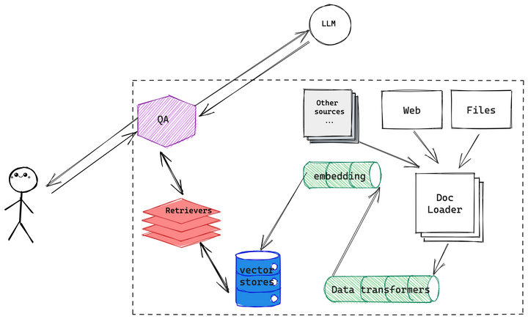
With RAG(retrieval augmented generation)

Slide 5
Example
A text file regarding LLM agent
Chunks: splitted into about 100 chunks
Question: how does memory work?

Slide 6
Example-search
systemPrompt:Only use the following information to answer the question. Do not use anything else: 1. Index: 24, Source Text: Types of Memory Memory can be defined as the processes used to acquire , store , retain , and later retrieve information . There are several types of memory in human brains . Sensory Memory : This is the earliest stage of memory , providing the ability to retain impressions of sensory information ( visual , auditory , etc ) after the original stimuli have ended . Sensory memory typically only lasts for up to a few seconds . Subcategories include iconic memory ( visual ) , echoic memory ( auditory ) , and haptic memory ( touch ) . Short-Term Memory ( STM ) or Working Memory : It stores information that we are currently aware of and needed to carry out complex cognitive tasks such as learning and reasoning . Short-term memory is believed to have the capacity of about 7 items ( Miller 1956 ) and lasts for 20-30 seconds . Long-Term Memory ( LTM ) : Long-term memory can store information for a remarkably long time , ranging from a few days to decades , with an essentially unlimited storage capacity .2. Index: 26, Source Text: There are two subtypes of LTM : Explicit / declarative memory : This is memory of facts and events , and refers to those memories that can be consciously recalled , including episodic memory ( events and experiences ) and semantic memory ( facts and concepts ) . Implicit / procedural memory : This type of memory is unconscious and involves skills and routines that are performed automatically , like riding a bike or typing on a keyboard . Fig . 8 . Categorization of human memory . We can roughly consider the following mappings : Sensory memory as learning embedding representations for raw inputs , including text , image or other modalities ; Short-term memory as in-context learning . It is short and finite , as it is restricted by the finite context window length of Transformer . Long-term memory as the external vector store that the agent can attend to at query time , accessible via fast retrieval . Maximum Inner Product Search ( MIPS ) The external memory can alleviate the restriction of finite attention span .3. Index: 25, Source Text: Short-Term Memory ( STM ) or Working Memory : It stores information that we are currently aware of and needed to carry out complex cognitive tasks such as learning and reasoning . Short-term memory is believed to have the capacity of about 7 items ( Miller 1956 ) and lasts for 20-30 seconds . Long-Term Memory ( LTM ) : Long-term memory can store information for a remarkably long time , ranging from a few days to decades , with an essentially unlimited storage capacity . There are two subtypes of LTM : Explicit / declarative memory : This is memory of facts and events , and refers to those memories that can be consciously recalled , including episodic memory ( events and experiences ) and semantic memory ( facts and concepts ) . Implicit / procedural memory : This type of memory is unconscious and involves skills and routines that are performed automatically , like riding a bike or typing on a keyboard . Fig . 8 . Categorization of human memory .4. Index: 23, Source Text: 7 . Comparison of AD , ED , source policy and RL^2 on environments that require memory and exploration . Only binary reward is assigned . The source policies are trained with A3C for `` dark '' environments and DQN for watermaze . ( Image source : Laskin et al . 2023 ) Component Two : Memory ( Big thank you to ChatGPT for helping me draft this section . I ’ ve learned a lot about the human brain and data structure for fast MIPS in my conversations with ChatGPT . ) Types of Memory Memory can be defined as the processes used to acquire , store , retain , and later retrieve information . There are several types of memory in human brains . Sensory Memory : This is the earliest stage of memory , providing the ability to retain impressions of sensory information ( visual , auditory , etc ) after the original stimuli have ended . Sensory memory typically only lasts for up to a few seconds . Subcategories include iconic memory ( visual ) , echoic memory ( auditory ) , and haptic memory ( touch ) .5. Index: 2, Source Text: Agent System Overview In a LLM-powered autonomous agent system , LLM functions as the agent ’ s brain , complemented by several key components : Planning Subgoal and decomposition : The agent breaks down large tasks into smaller , manageable subgoals , enabling efficient handling of complex tasks . Reflection and refinement : The agent can do self-criticism and self-reflection over past actions , learn from mistakes and refine them for future steps , thereby improving the quality of final results . Memory Short-term memory : I would consider all the in-context learning ( See Prompt Engineering ) as utilizing short-term memory of the model to learn . Long-term memory : This provides the agent with the capability to retain and recall ( infinite ) information over extended periods , often by leveraging an external vector store and fast retrieval .

Slide 7
Example-llama2 prompt
<s>[INST] <<SYS>>
systemPrompt:Only use the following information to answer the question. Do not use anything else: 1. Index: 24, Source Text: Types of Memory Memory can be defined as the processes used to acquire , store , retain , and later retrieve information . There are several types of memory in human brains . Sensory Memory : This is the earliest stage of memory , providing the ability to retain impressions of sensory information ( visual , auditory , etc ) after the original stimuli have ended . Sensory memory typically only lasts for up to a few seconds . Subcategories include iconic memory ( visual ) , echoic memory ( auditory ) , and haptic memory ( touch ) . Short-Term Memory ( STM ) or Working Memory : It stores information that we are currently aware of and needed to carry out complex cognitive tasks such as learning and reasoning . Short-term memory is believed to have the capacity of about 7 items ( Miller 1956 ) and lasts for 20-30 seconds . Long-Term Memory ( LTM ) : Long-term memory can store information for a remarkably long time , ranging from a few days to decades , with an essentially unlimited storage capacity
<</SYS>>
how does memory work? answer within 50 words.
[/INST]

Slide 8
Example-result:
Memory works by processing sensory information, storing it in short-term or long-term memory, and retrieving it later for conscious recall or unconscious use. The brain has different types of memory, including sensory, short-term, and long-term memory, each with its own capacity and duration.

Slide 9
chunking
index:0, text:Building agents with LLM ( large language model ) as its core controller is a cool concept . Several proof-of-concepts demos , such as AutoGPT , GPT-Engineer and BabyAGI , serve as inspiring examples . The potentiality of LLM extends beyond generating well-written copies , stories , essays and programs ; it can be framed as a powerful general problem solver .
index:1, text:Building agents with LLM ( large language model ) as its core controller is a cool concept . Several proof-of-concepts demos , such as AutoGPT , GPT-Engineer and BabyAGI , serve as inspiring examples . The potentiality of LLM extends beyond generating well-written copies , stories , essays and programs ; it can be framed as a powerful general problem solver . Agent System Overview In a LLM-powered autonomous agent system , LLM functions as the agent ’ s brain , complemented by several key components : Planning Subgoal and decomposition : The agent breaks down large tasks into smaller , manageable subgoals , enabling efficient handling of complex tasks . Reflection and refinement : The agent can do self-criticism and self-reflection over past actions , learn from mistakes and refine them for future steps , thereby improving the quality of final results .
index:2, text:Agent System Overview In a LLM-powered autonomous agent system , LLM functions as the agent ’ s brain , complemented by several key components : Planning Subgoal and decomposition : The agent breaks down large tasks into smaller , manageable subgoals , enabling efficient handling of complex tasks . Reflection and refinement : The agent can do self-criticism and self-reflection over past actions , learn from mistakes and refine them for future steps , thereby improving the quality of final results . Memory Short-term memory : I would consider all the in-context learning ( See Prompt Engineering ) as utilizing short-term memory of the model to learn . Long-term memory : This provides the agent with the capability to retain and recall ( infinite ) information over extended periods , often by leveraging an external vector store and fast retrieval .
index:3, text:Memory Short-term memory : I would consider all the in-context learning ( See Prompt Engineering ) as utilizing short-term memory of the model to learn . Long-term memory : This provides the agent with the capability to retain and recall ( infinite ) information over extended periods , often by leveraging an external vector store and fast retrieval . Tool use The agent learns to call external APIs for extra information that is missing from the model weights ( often hard to change after pre-training ) , including current information , code execution capability , access to proprietary information sources and more . Fig . 1 . Overview of a LLM-powered autonomous agent system . Component One : Planning A complicated task usually involves many steps . An agent needs to know what they are and plan ahead . Task Decomposition Chain of thought ( CoT ; Wei et al .

Slide 10
Similarity search
import numpy as np
from sklearn.neighbors import NearestNeighbors
# Perform K-nearest neighbors (KNN) search
def knn_search(question_embedding, embeddings, k=5):
X = np.array([item['embedding'] for article in embeddings for item in article['embeddings']])
source_texts = [item['source'] for article in embeddings for item in article['embeddings']]
# Fit a KNN model on the embeddings
knn = NearestNeighbors(n_neighbors=k, metric='cosine')
knn.fit(X)
# Find the indices and distances of the k-nearest neighbors
distances, indices = knn.kneighbors(question_embedding, n_neighbors=k)
# Get the indices and source texts of the best matches
best_matches = [(indices[0][i], source_texts[indices[0][i]]) for i in range(k)]
return best_matches

Slide 11
LLM search with Prompts
def query(question):
context = []
# Embed the user's question
question_embedding = model.encode([question]) # Perform KNN search to find the best matches (indices and source text)
best_matches = knn_search(question_embedding, enhanced_kb.vectorized_knowledge, k=5) sourcetext=""
for i, (index, source_text) in enumerate(best_matches, start=1):
sourcetext += f"{i}. Index: {index}, Source Text: {source_text}"
systemPrompt = f"Only use the following information to answer the question. Do not use anything else: {sourcetext}" payload = {"model": "llama2",#"mistral-openorca", "prompt": question, "system": systemPrompt, "stream": False, "context": context} # Convert the payload to a JSON string
payload_json = json.dumps(payload) # Send the POST request
response = requests.post(url, data=payload_json, headers={"Content-Type": "application/json"})

Slide 12
Llama Inference code
prompt_template="""
<s>[INST] <<SYS>>
*system_prompt*
<</SYS>>
*user_message*
[/INST]
""" def summarize_hf(user_message, system_prompt="", temperature=1, output_len = 100, top_k=1, num_beams=1):
text = prompt_template.replace("*system_prompt*", system_prompt).replace("*user_message*", user_message) with torch.no_grad():
output = model.generate(line_encoded,
max_length=len(line_encoded[0]) + output_len,
top_k=top_k,
temperature=temperature,
eos_token_id=tokenizer.eos_token_id,
pad_token_id=tokenizer.pad_token_id,
num_beams=num_beams,
num_return_sequences=num_beams,
early_stopping=True)
tokens_list = output[:, len(line_encoded[0]):].tolist()
output = output.reshape([1, num_beams, -1])
output_lines_list = [
tokenizer.batch_decode(output[:, i, len(line_encoded[0]):],
skip_special_tokens=True)
for i in range(num_beams)
]
return output_lines_list, tokens_list

Slide 13
TODO
Chinese llama
LLM streaming output: first token latency, etc
Performance improvement: batch size/KV cache/output length
ASR

Slide 14
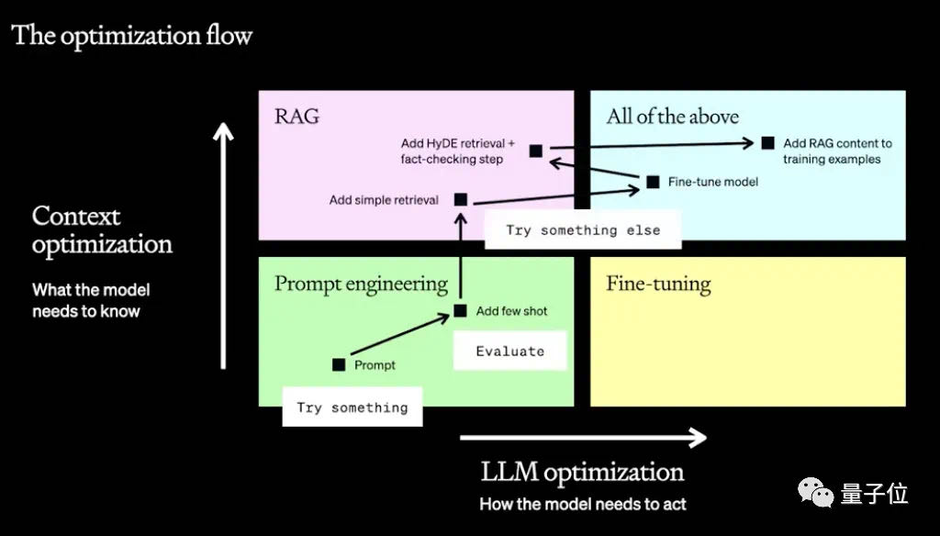
OpenAI optimization flow

